Slide 1
Application of Synthesis Approaches
Robert Wille
Johannes Kepler University Linz, Austria
robert.wille@jku.at

Slide 2
Applications
Quantum Computation

Slide 3
Applications
Quantum Computation → Later today

Slide 4
Applications
Quantum Computation → Later today
Low Power Design

Slide 5
Low Power Design #1
Rolf Landauer (1961):
Deletion of a single bit leads to a power dissipation of W = kT ln 2
T…Temperature
k…Boltzmann-Constant
(1,381·10⁻²³ J/K)
Charles H. Bennett (1973):
Circuits without energy dissipation have to be reversible

Slide 6
Low Power Design #2
Important: Does not mean that each implementation of a reversible circuit is “automatically” power-efficient!
→ How to exploit reversibility for reducing power dissipation still open research problem
Power
Landauer’s Barrier
Less power consumption is only possible if computation is reversible
2010 2020 2030

Slide 7
Applications
Quantum Computation → Later today
Low Power Design
Adiabatic Circuits

Slide 8
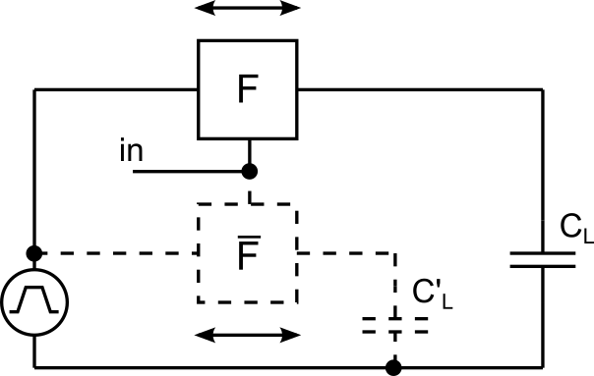
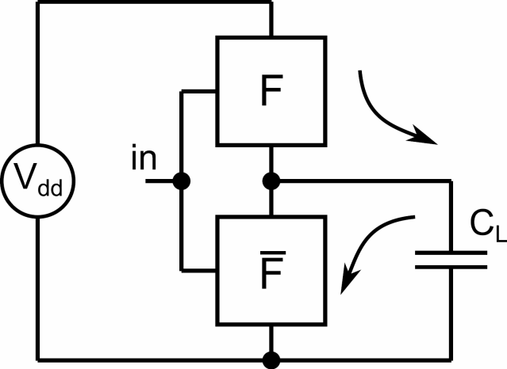
Adiabatic Circuits
adiabatic (from Thermodynamics)
no transfer of heat or matter into or out of the system
adiabatic (in electronics)
no (or minimal) energy loss
Notes:
The term adiabatic is coming from thermodynamics describing processes that do not exchange heat with the environment or dissipate heat. In electronics it describes a group of circuits that do not dissipate energy but reuses it.
In conventional logic, the output node is charged via the supply line for a logic “1” and discharged to ground for a logic “0” resulting in a significant energy loss.
The idea behind adibatic logic is to regain the energy used to charge the output node, instead of dissipating it to ground as in conventional logic. This can be done by using a pulsing power supply, that draws back the energy it provided during charging the output node in a separate discharge phase.

Slide 9
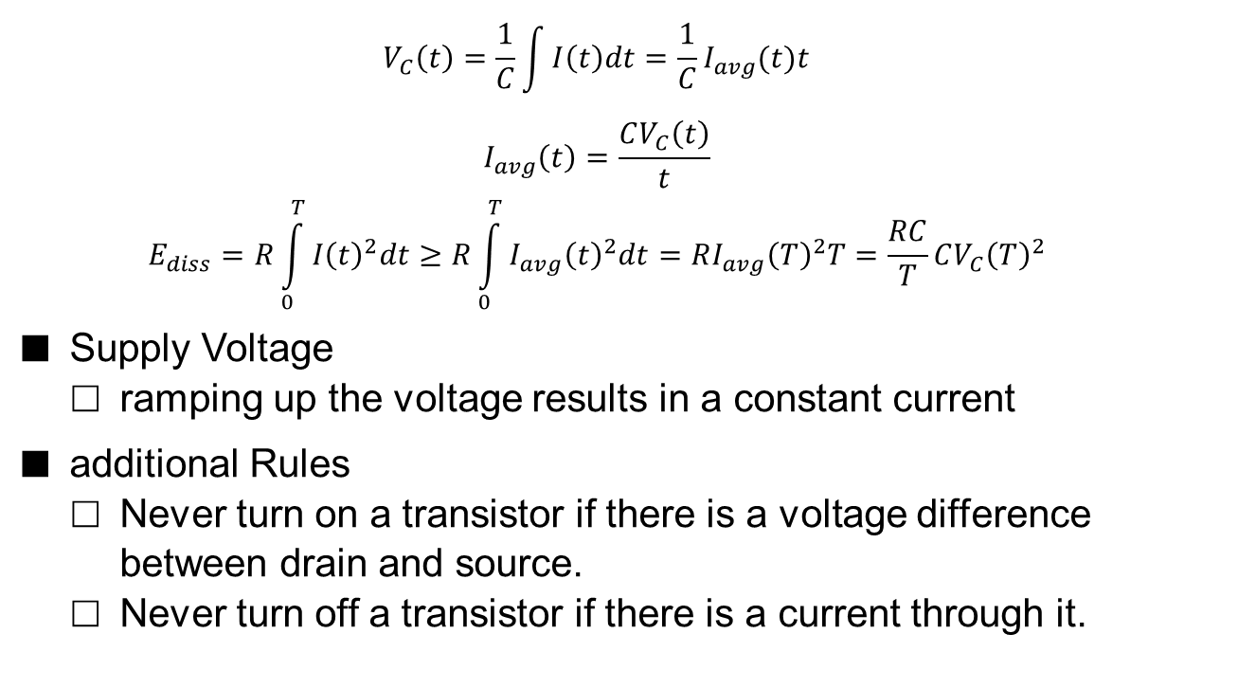
Adiabatic Charging
$$V_{C}\left(t\right)=\frac{1}{C}\int{I\left(t\right)dt}=\frac{1}{C}I_{avg}(t)t$$
$$I_{avg}\left(t\right)=\frac{CV_{C}\left(t\right)}{t}$$
$$E_{diss}=R\int_{0}^{T}{I{\left(t\right)}^{2}dt}≥R\int_{0}^{T}{I_{avg}{\left(t\right)}^{2}dt}=RI_{avg}{\left(T\right)}^{2}T=\frac{RC}{T}CV_{C}{\left(T\right)}^{2}$$
Supply Voltage
ramping up the voltage results in a constant current
additional Rules
Never turn on a transistor if there is a voltage difference between drain and source.
Never turn off a transistor if there is a current through it.
Notes:
Charging can be discribed by the presented formulas. The voltage across the capacitance CL is given by the first equation with Iavg being the average
current over time. The energy dissipated in R is presented in the third equation. For a constant current the becomes a = and therfore it can be said that the energy
dissipated is at minimum. For all other waveforms the energy dissipated is bigger. It can be seen that the term can be controlled. Mainly by increasing T, the time it takes to load the capacitance, the lost energy can be reduced. This can be done by slowly ramping up the supply voltage instead of simply applying it as for conventional charging. In this way it is possible to trade speed for a reduction in energy consumption. In addition, ramping up the voltage results in a constant current, as it is desired.
Two additional rules have to be applied in adiabatic circuits.
Increaseing T by eleminating turn on time from charge phase (rule 1)
energy is dissipated when turnin off a transistor if there is a current through it

Slide 10
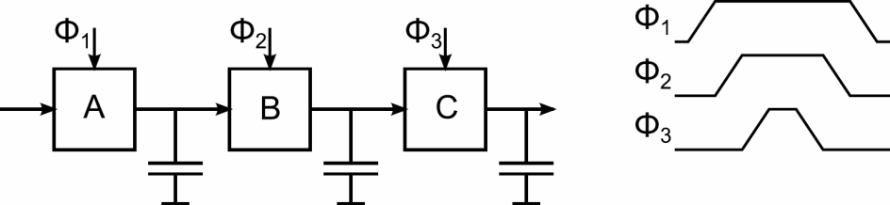
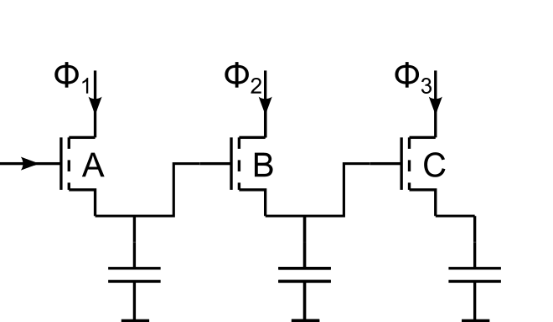
Complex Adiabatic Circuits
pipeline structure
To respect the rules mentioned
A must not change until B has been charged and discharged
B must not change until C has been charged and discharged
Notes:
To be able to realize more complex functions with multiple stages, one must be careful to respect the rules already mentioned and to allow the whole circuit to be charged and discharged. If an input signal has to be passed through the displayed circuit, first Phi1 has to charge the output node of gate A. This output is now used as input to gate B and so on. To be able to discharge the final output node C, B has to be kept stable so the charge can be retrieved through the same path as it has been provided. Thus A has to be kept stable until C has been discharged and then B has been discharge. Only after all preceding stages have been discharged one gate is allowed to be discharged. This leads to a power clock scheme shown. The cells get charged in ascending order and discharged in descending order, that is highly impractical. A possible solution is to use separate charge and discharge paths.

Slide 11
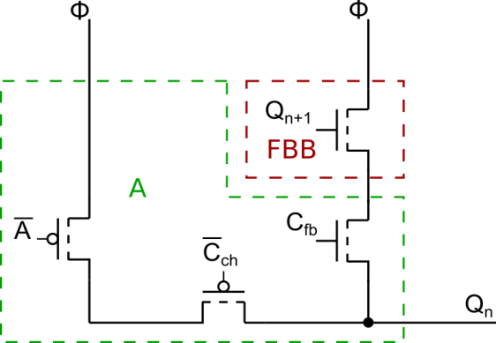
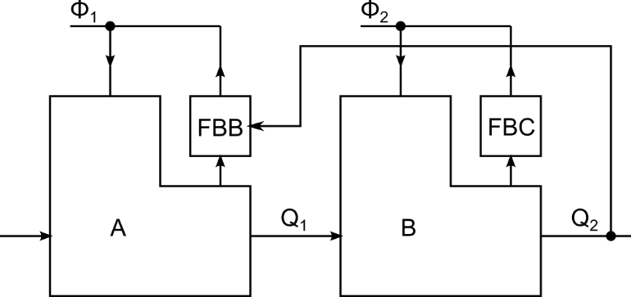
Separate Discharge Path
Input is allowed to change before discharge phase
Signal has no longer to propagate through whole chain and back
Notes:
A separate discharge path provides the possibility for the input to change before the circuit gets discharged. A possible circuit design is shown here. The first PMOS transistor with input notA realizes the function of the gate. The second one with input notCch is used to separate the charge path from the output node. The two NMOS transistors are used to separate the output node from the discharge path and establish the dischrage path depending wether there is a charge to be retrieved or not.

Slide 12
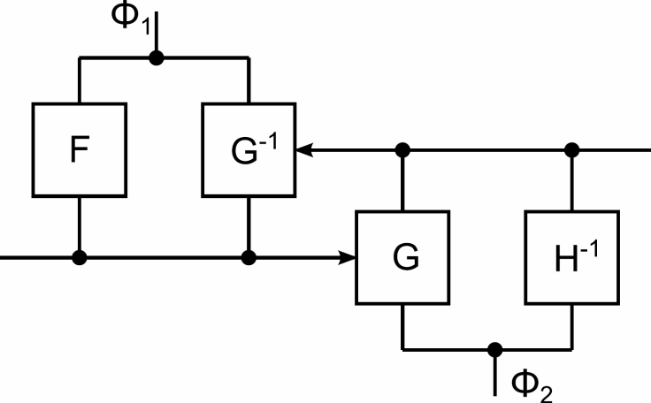
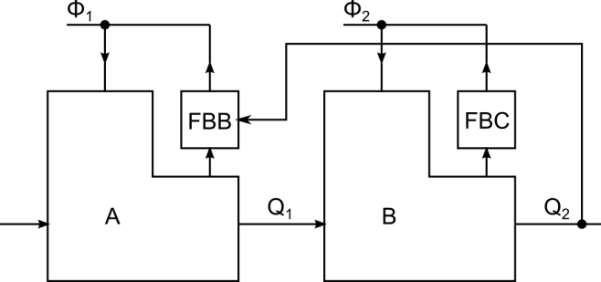
Discharge Path
Never turn on a transistor if there is a voltage difference between drain and source
Discharge ONLY when charged!
State (charged/uncharged) of cell F can be determined by output of following cell G via function G⁻¹
Output of following cell G controlls discharge path of F
G must be reversible to realize G⁻¹
Notes:
As already mentioned, the circuit gets only discharged if there is actually a charge to be discharged. Otherwise the rule „Never turn on a transistor if there is a voltage difference between drain and source” gets violated. Thus it is necessery to determine if the discharge path should be activated or not. For this purpose, the output signal of the following gate Q2 can be used, but only if Q1 can be reconstructed from it. This is the case if the function G of gate B is reversible. Then the discharge path of gate A (FBB) has the function G^-1 and reconstructs Q1. This results in a pipeline structure that requires multiple phases. A charging phase, where the gate gets charged, an evaluate phase when the following stage evaluates its output depending on actual gates ouutput, and a discharge phse when the charge is rerieved by the pulsing power supply. Unfortunately a complex clocking scheme has to be used to control such a pipelined circuit.

Slide 13
Discharge Path
Never turn on a transistor if there is a voltage difference between drain and source
Discharge ONLY when charged!
State (charged/uncharged) of cell F can be determined by output of following cell G via function G⁻¹
Output of following cell G controlls discharge path of F
G must be reversible to realize G⁻¹
Notes:
As already mentioned, the circuit gets only discharged if there is actually a charge to be discharged. Otherwise the rule „Never turn on a transistor if there is a voltage difference between drain and source” gets violated. Thus it is necessery to determine if the discharge path should be activated or not. For this purpose, the output signal of the following gate Q2 can be used, but only if Q1 can be reconstructed from it. This is the case if the function G of gate B is reversible. Then the discharge path of gate A (FBB) has the function G^-1 and reconstructs Q1. This results in a pipeline structure that requires multiple phases. A charging phase, where the gate gets charged, an evaluate phase when the following stage evaluates its output depending on actual gates ouutput, and a discharge phse when the charge is rerieved by the pulsing power supply. Unfortunately a complex clocking scheme has to be used to control such a pipelined circuit.

Slide 14
Applications
Quantum Computation → Later today
Low Power Design
Adiabatic Circuits
Encoders

Slide 15
Encoders
Complete
Incomplete
Application-specific
Challenges
Exponential Complexity
Guaranteeing one-to-one mappings
Exploiting the full degree of freedom

Slide 16

Using Reversible Logic
Reversible circuits: Get a 1:1 mapping “for free”!
Challenges
Exponential Complexity
Guaranteeing one-to-one mappings
Exploiting the full degree of freedom
a
1
1
1
1
a'
1
0
1
1
b
b'
0
1
1
c
1
c'

Slide 17
Using Reversible Logic
Application-specific
Challenges
Exponential Complexity
Guaranteeing one-to-one mappings
Exploiting the full degree of freedom
State-of-the-art:
Using Reversible Logic:

Slide 18
Using Reversible Logic
QMDDs
Challenges
Exponential Complexity
Guaranteeing one-to-one mappings
Exploiting the full degree of freedom

Slide 19
Applications
Quantum Computation → Later today
Low Power Design
Adiabatic Circuits
Encoders
Further
Complete Simulation

Slide 20
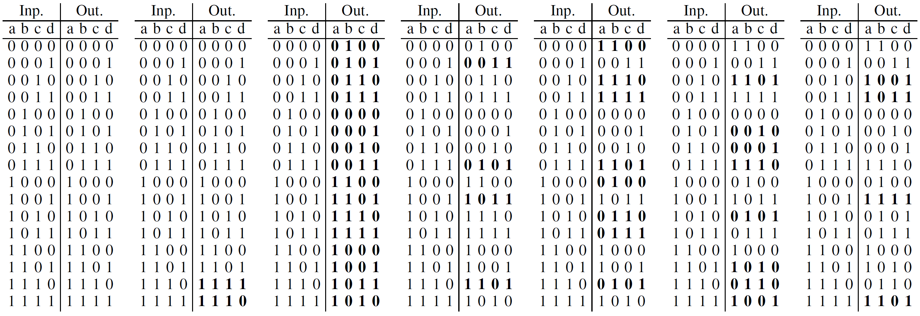
Complete Simulation
g₁ g₂ g₃ g₄ g₅ g₆
0
0
0
0
1
1
0
1
0
1
1
1
1
0
…
0
1
0
0
0
0
0
0
0
0
1
0
0
0
0
0
0
0
Run-time complexity: 2^{n}d (n: number of line; d: number of gates)

Slide 21
Exploiting Reversibility
Functional effect of single gates
For many input pattern, single gates have no effect (only patterns with control lines set to 1)
Reversible gates realize permutations
If an input pattern 0000 maps to the output 0001, then 0001 also maps to 0000 → Each gate eventually leads to an exchange of patterns

Slide 22
Exploiting Reversibility
Reversible gates realize permutations
g₁: Swaps 1110 and 1111
…
g₆: Swaps all pattern of the form 11-1 with corresponding pattern of the form 10-1
g₁ g₂ g₃ g₄ g₅ g₆
Input patterns with effect:
g₁: 2
g₂: 16
g₃: 8
g₄: 8
g₅: 16
g₆: 4

Slide 23
Exploiting Reversibility
Reversible gates realize permutations
g₁: Swaps 1110 and 1111
➔ Simulation of g₁ requires a single swap operation (compared to 16 simulation steps)
g₁ g₂ g₃ g₄ g₅ g₆
Input patterns with effect:
g₁: 2

Slide 24
Applications
Quantum Computation → Later today
Low Power Design
Adiabatic Circuits
Encoders
Further
Complete Simulation
ATPG

Slide 25
Test of Reversible Circuits
Generate an input assignment that
triggers the faulty behavior (controlability)
shows the faulty behavior (observability)
In general easy for reversible circuits (except additional restrictions like constant inputs need to be considered)
1
1
1
0
0
0
1
1
1
0
0
0
1
1
1
1
1
1
1
1

Slide 26
Design for Testability

Slide 27
Applications
Quantum Computation → Later today
Low Power Design
Adiabatic Circuits
Encoders
Further
Complete Simulation
ATPG
Verification

Slide 28
Verification/ Equivalence Checking
Full connectivity (verification by simulation is more promising)

Slide 29
Verification/ Equivalence Checking
Full connectivity (verification by simulation is more promising)
Search space is smaller
Reversible Miter (ff⁻¹)

Slide 30
Verification/ Equivalence Checking
Full connectivity (verification by simulation is more promising)
Search space is smaller
Reversible Miter (ff⁻¹)
XOR-richness
Undo computations when an error occurred
…

Slide 31
Applications
Quantum Computation → Later today
Low Power Design
Adiabatic Circuits
Encoders
Further
Complete Simulation
ATPG
Verification

Slide 32
Further Reading
Adiabatic Circuits Foundations of Generalized Reversible Computing, RC 2017 Exploiting Reversible Logic Design for Implementing Adiabatic Circuits, MIXDES 2017
Encoder Design Taking One-to-one Mappings for Granted: Advanced Logic Design of Encoder Circuits, DATE 2017 Synthesis of Approximate Coders for On-chip Interconnects Using Reversible Logic, DATE 2016 Automatic Design of Low-Power Encoders Using Reversible Circuit Synthesis, DATE 2012
Simulation Exploiting Reversibility in the Complete Simulation of Reversible Circuits, AFRICON 2013
ATPG A Family of Logical Fault Models for Reversible Circuits, ATS 2015
Verification Exploiting Inherent Characteristics of Reversible Circuits for Faster Combinational Equivalence Checking, DATE 2016

